Slide 1
Pandora’s box
From Italy to Greece

Slide 2
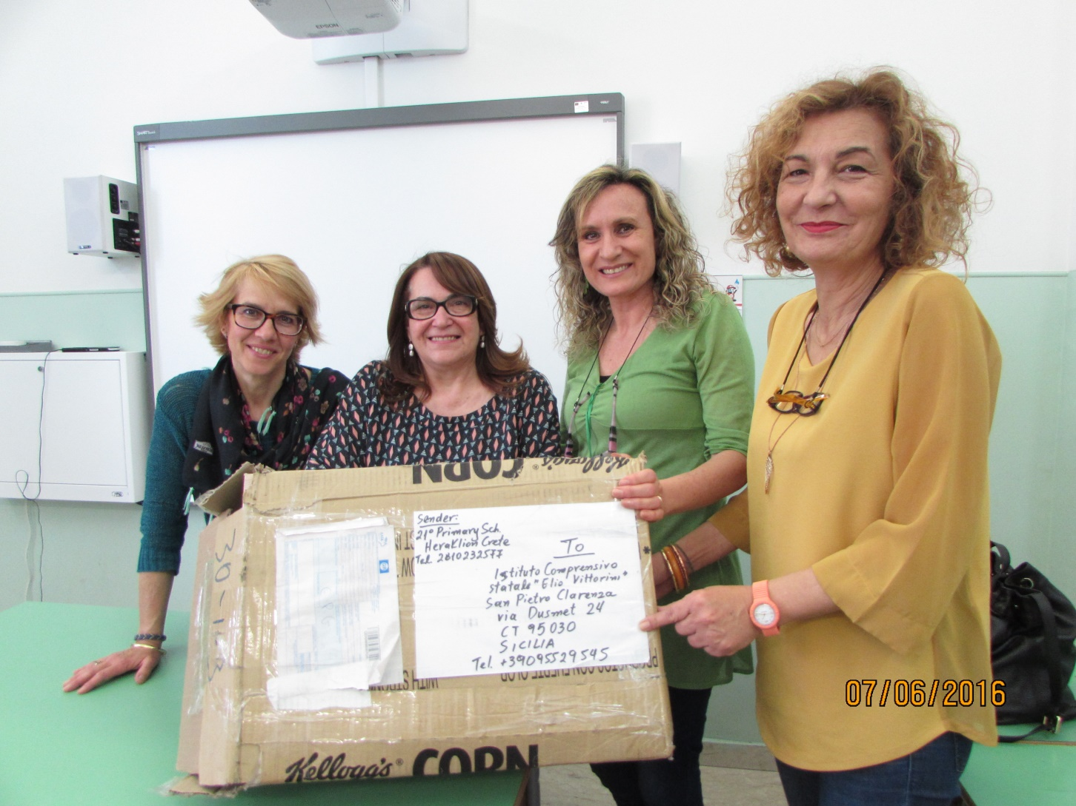
Pandora’s box

Slide 3
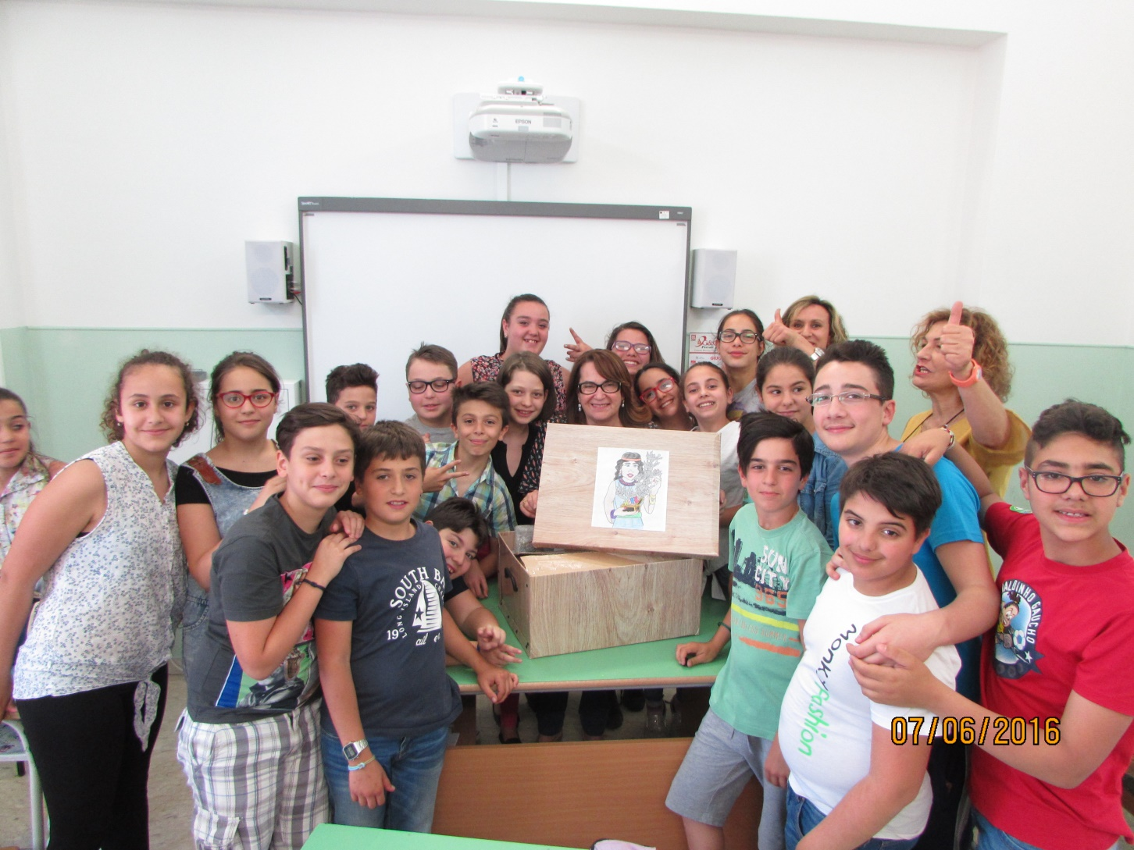
Pandora’s box

Slide 4
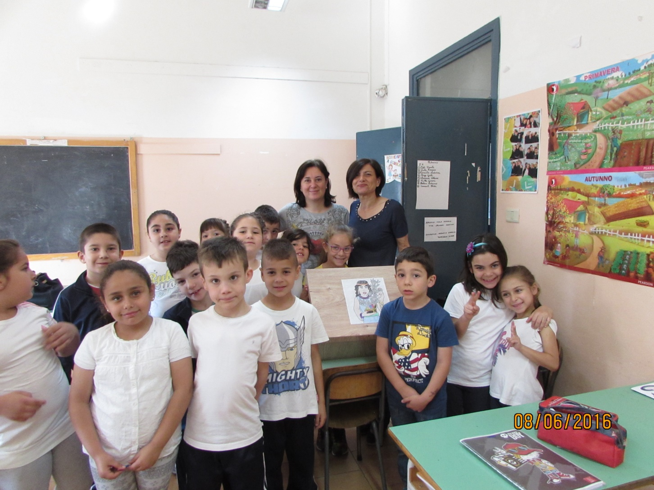
Pandora’s box

Slide 5

Pandora’s box

Slide 6
Pandora’s box
Thank you, Greece!

Slide 7
Pandora’s box

